Slide 1
50V DC VOLTMETER
MADE BY:-
احمد زكريا عبد العال
احمد محمد محمود
اسلام محمود توفيق
احمد فتحي عواد
اشرف محمد ابراهيم
رمزي احمد رمزي
DR\TAREK EL-KAMMAR
ENG\MOATASEM

Slide 2
THE EQUIPMENTS USED:-
LCD 16x2
Resistors(2k-18k)
Wires
22pf capacitors
8MHZ crystal oscillator
Dc source 5v
Voltage regulators 7805
Pot
PIC 16f877a microcontroller

Slide 3
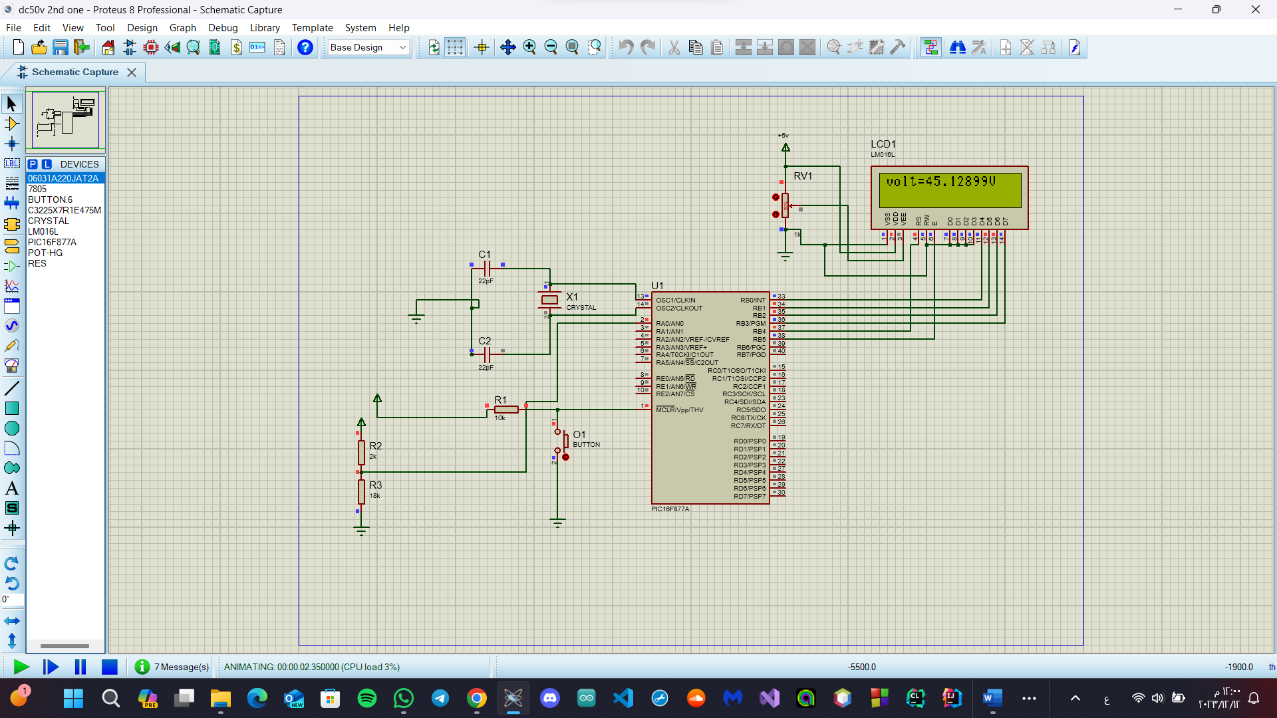
The circuit diagram:-

Slide 4
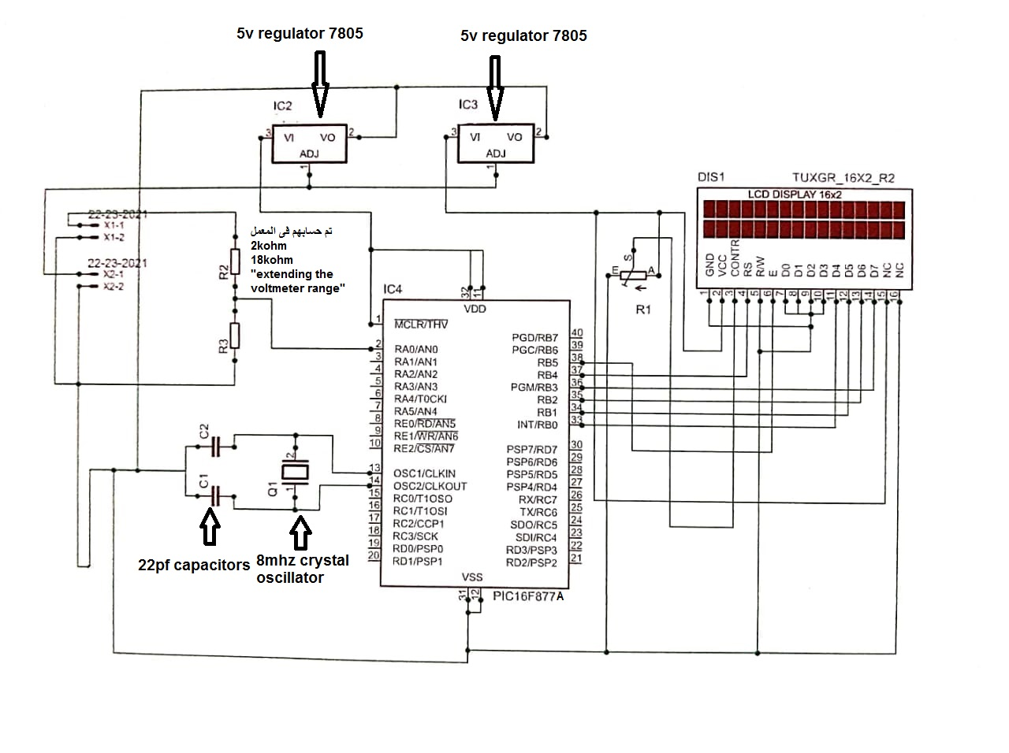

Slide 5
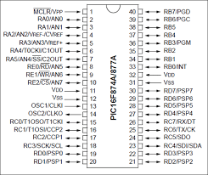
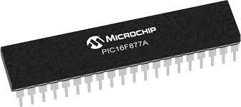
Pic16f877a:-

Slide 6
Electrical Characteristics
Operating Voltage Range: 4.0V to 5.5V
Input Low Voltage (VIL): -0.3V to 0.8V
Input High Voltage (VIH): 2.0V to VDD + 0.3V
Output Low Voltage (VOL): 0.6V maximum at 4.0mA sink current
Output High Voltage (VOH): VDD - 0.6V minimum at 3.2mA source current
Input Leakage Current (IIL): ±1 μA maximum at VDD = 5.5V
Input Capacitance (CIN): 10 pF maximum
Operating Current (I_DD):
13 mA typical at 4 MHz, 5V
35 mA typical at 20 MHz, 5V

Slide 7
Sleep Current (I_SLEEP):
1 μA typical at 5V, typical conditions
Brown-out Reset (BOR) Thresholds:
VBOR = 4.0V typical
VBOR = 4.3V typical
VBOR = 4.6V typical
Power-up Timer (PWRT): 72 ms typical at 5V
Power-on Reset (POR):
VDD rising: 1 ms typical at 5V
VDD falling: 2 ms typical at 5V

Slide 8
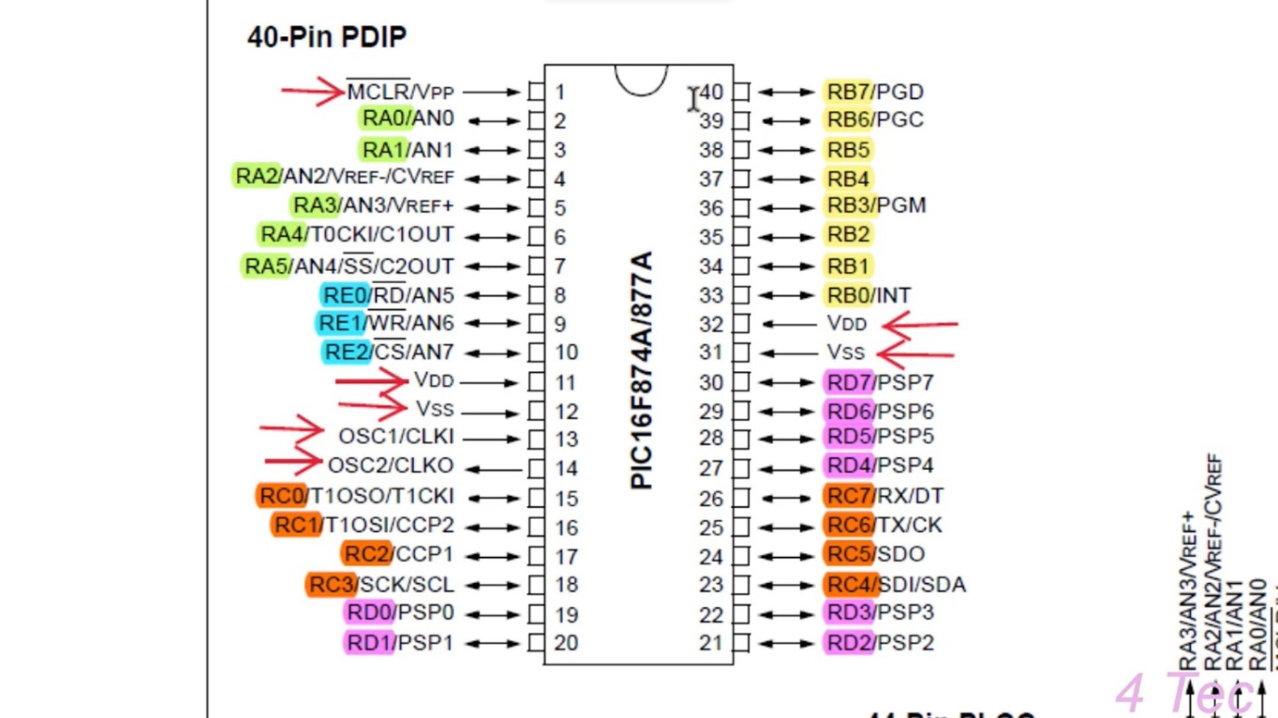
The pic microcontroler pins:-

Slide 9
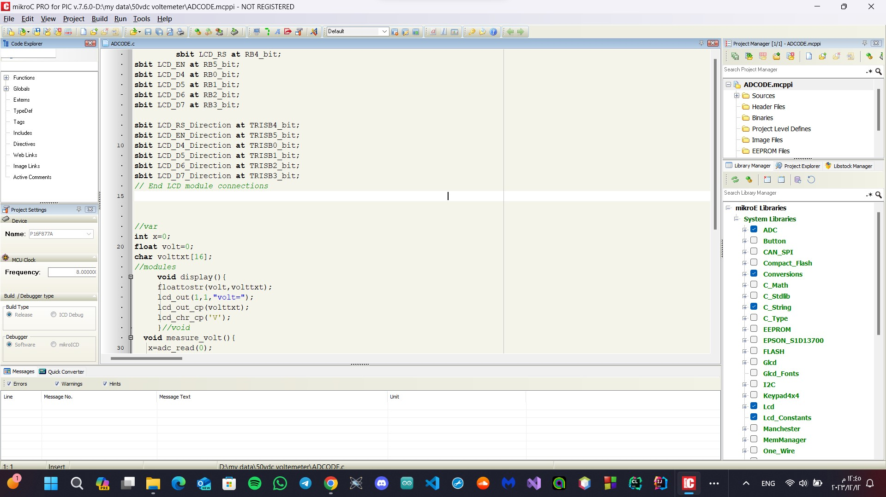
The codes

Slide 10
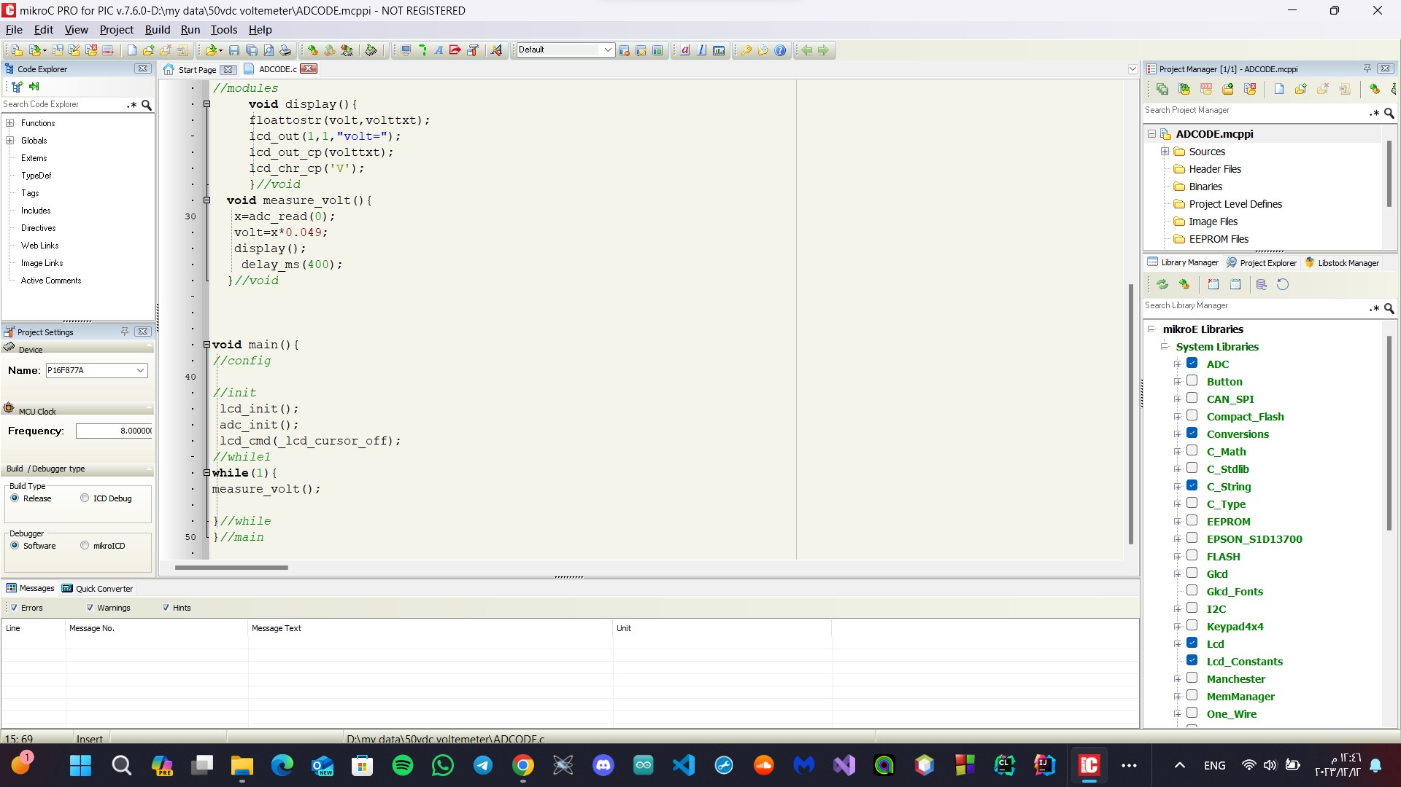

Slide 11
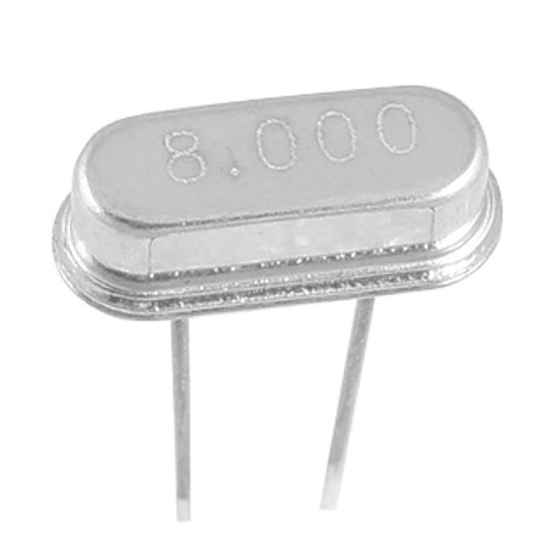
The crystal ocsillator:-
What is a crystal oscillator?
A crystal oscillator is an electronic circuit that uses a piezoelectric crystal to generate a precise, stable electrical signal with a specific frequency.
The crystal acts like a tiny tuning fork, vibrating at a very specific frequency when an electric field is applied.
This vibration is converted back into an electrical signal by the same piezoelectric effect, creating a highly accurate and stable clock signal

Slide 12
Why is a crystal oscillator important for the PIC16F877A?
The PIC16F877A relies on a clock signal to determine its timing and execution of instructions.
A precise and stable clock signal ensures accurate timing for all internal operations, such as fetching instructions, performing calculations, and communicating with peripherals.

Slide 13
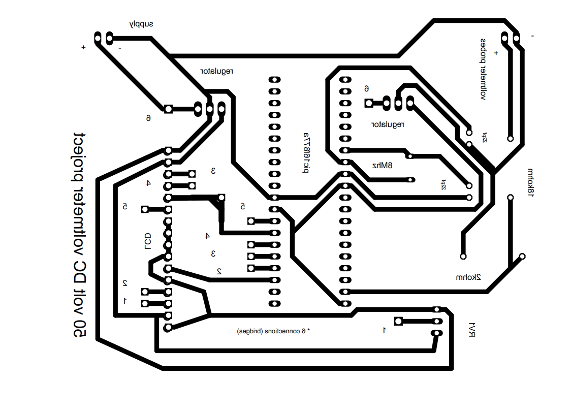
PCP LAYOUT:-

